Slide 1
Lecture 3: Flutter Basics
SEB-312
Sidra Khatoon

Slide 2
What is Flutter Architecture?
The architecture of Flutter defines how its components are organized and their interactions. Flutter is based on a layered architecture which means that the whole Flutter system is divided into different layers of components. There are many separate libraries which are dependent on each of these layers.
Flutter operates with replaceable parts that are arranged in sequence and no layer can exclusively access the lower layer. As a result, this design offers greater flexibility and extensibility allowing developers to replace or modify one or more parts without affecting the entire system.
Notes:
Widget tree means nesting. We have to build component tree. Means we have to build widget tree

Slide 3
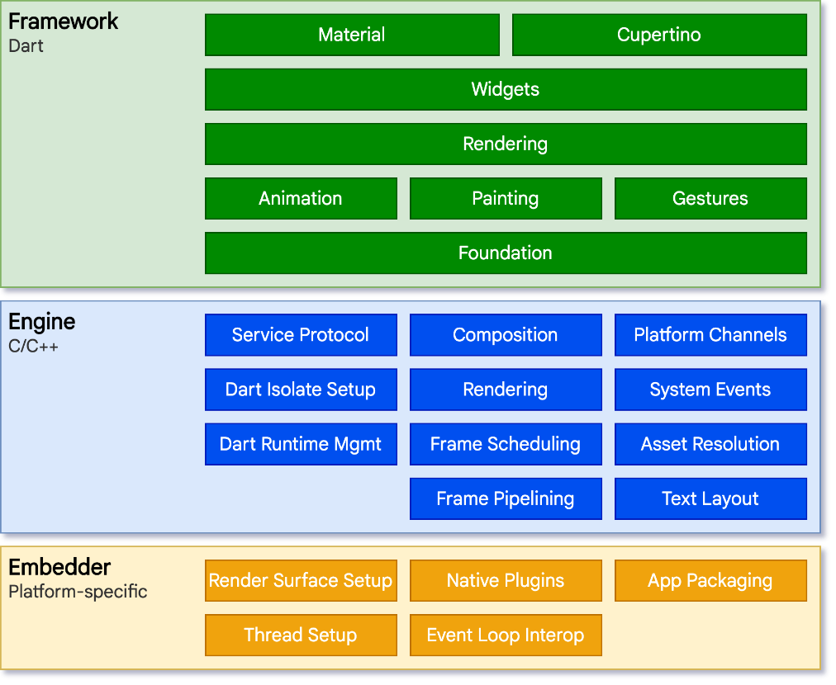
Flutter Architecture

Slide 4
Flutter architecture
The architecture of Flutter consists of three development layers. The lowest one is the Embedder, on top of which is the Flutter Engine, and on top of that is the Flutter framework.
Embedder: The embedder layers undertake the heavy lifting necessary to translate how Flutter language works with the particular operating system. It creates an entry point and coordinates with the OS to deliver services like rendering surfacing, message event loop management, inputs, and accessibility.
Flutter Engine: Written in C++, this Flutter engine tackles and handles the heavy liftings in software development like the network requests, input, and output, along with managing the complex translations of rendering.

Slide 5
Flutter architecture
Flutter Framework: It is a very core part of Flutter app architecture. Flutter framework has got the material parts, widgets, or the cupertino, and it becomes the foundation element of application development. This is that part of the Flutter architecture where most of the developers live because developers can easily use these Flutter framework parts and Flutter just renders the stuff. Flutter makes it easy and robust to use the out-of-the-box widgets, animations, gesture detectors, or anything you require for custom software development.

Slide 6
What is Widgets:
Each element on the screen of the Flutter app is a widget.
The view of the screen completely depends upon the choice and sequence of the widgets used to build the apps.
The structure of the code of apps is a tree of widgets.

Slide 7
Category of Widgets
Widgets | Description
Accessibility | These are the set of widgets that make a Flutter app more easily accessible.
Animation and Motion | These widgets add animation to other widgets.
Assets, Images, and Icons | These widgets take charge of assets such as display images and show icons.
Async | These provide async functionality in the Flutter application.
Basics | These are the bundle of widgets that are absolutely necessary for the development of any Flutter application.
Cupertino | These are the iOS-designed widgets.

Slide 8
Category of Widgets
Widgets | Description
Input | This set of widgets provides input functionality in a Flutter application.
Interaction Models | These widgets are here to manage touch events and route users to different views in the application.
Layout | This bundle of widgets helps in placing the other widgets on the screen as needed.
Material Components | This is a set of widgets that mainly follow material design by Google.
Painting and effects | This is the set of widgets that apply visual changes to their child widgets without changing their layout or shape.
Scrolling | This provides scrollability of to a set of other widgets that are not scrollable by default.

Slide 9
Types of Widgets
There are broadly two types of widgets in the flutter:
Stateless Widget: Stateless Widget is a type of widget which once built , then it’s properties and state can’t be changed. These widgets are immutable, once created can’t be modified. Example: Display Text , Icons, Images, etc.
Stateful Widget: Stateful Widgets is a type of widget that can change state. It can maintain and update the appearance in the response to change in state. Examples: Buttons, Sliders, Text Fields, etc.

Slide 10
Container
It is a widget that combines common painting, positioning and sizing of child widgets.
It is also a class to store one i=or more widgets and position them on the screen according to our needs.
Generally, it is similar to a box for storing contents.
It allows many attributes to the user for decorating its child widgets such as using margin, which separates the container with other contents

Slide 11
Text Widget
The text widget displays a string of text with single style
The string might break across multiple lines or might all be displayed on the same line depending on the layout constraints

Slide 12
Button Widget
Buttons are graphical control elements that provides
A user to trigger n event such as taking actions, making choices, searching things and many more. They can be paced anywhere in our UI like dialogs, forms, cards, toolbars etc.
Types of Button
Text button
Elevated Button
Outlined Button

Slide 13
Image Widget
Image widget is an essential widget in Flutter because without image you cannot develop a beautiful app.
Images express the content better than text.
You can use the Flutter Image widget in 6 ways such as FadeInImage, Ink Image, Asset Image, Network Image, Memory Image, and File Image.

Slide 14
Row and Column Widgets
Row and Column are the two most important and powerful widgets in Flutter.
These widgets let you align children horizontally and vertically as per the requirement.
As we know that when we design any UI(User Interface) in a flutter, we need to arrange its content in the Row and Column manner so these Row and Column widgets are required when designing UI.

Slide 15
Key Points
Row and Column widgets are the most commonly used layout patterns in the Flutter application.
Both may take several child widgets.
A child widget can also be a row or column widget.
We can stretch or constrain a particular children's widget.
Flutter also allows developers to specify how child widgets can use row and column widgets' available space.

Slide 16
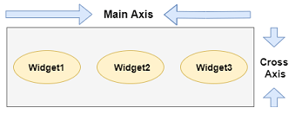
Row Widget
This widget arranges its children in a horizontal direction on the screen. In other words, it will expect child widgets in a horizontal array. If the child widgets need to fill the available horizontal space, we must wrap the children widgets in an Expanded widget.
A row widget does not appear scrollable because it displays the widgets within the visible view. So it is considered wrong if we have more children in a row which will not fit in the available space. If we want to make a scrollable list of row widgets, we need to use the ListView widget.
We can control how a row widget aligns its children based on our choice using the property crossAxisAlignment and mainAxisAlignment. The row's cross-axis will run vertically, and the main axis will run horizontally. See the below visual representation to understand it more clearly.

Slide 17
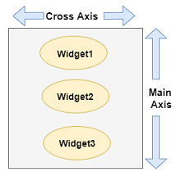
Column Widget
This widget arranges its children in a vertical direction on the screen. In other words, it will expect a vertical array of children widgets. If the child widgets need to fill the available vertical space, we must wrap the children widgets in an Expanded widget.
A column widget does not appear scrollable because it displays the widgets within the visible view. So it is considered wrong if we have more children in a column which will not fit in the available space. If we want to make a scrollable list of column widgets, we need to use the ListView Widget.
We can also control how a column widget aligns its children using the property mainAxisAlignment and crossAxisAlignment. The column's cross-axis will run horizontally, and the main axis will run vertically. The below visual representation explains it more clearly.

Slide 18
Hot Reload
Developers waste a lot of time updating the code base and executing the app over and over again to see the effect of modified code. With hot reload developers can quickly see the updated UI in the Flutter app.
Updating the application while keeping the app’s current state can be challenging. Consider you are updating one of the UI components which is only accessible to premium users. In such a situation you might need to log in every time to test the component after it is updated.
Hot reload does not destroy the preserved state on app updates, so the developers can easily see UI updates and continue testing. Thus it saves the developers time and increases productivity.

Slide 19
Hot Restart
Flutter hot restart has different functionality than the hot reload, it is used in the special cases where hot restart doesn’t work. It works faster as compared to the full restart function but takes more time as compared to the hot reload.
When you use hot restart unlike hot reload it destroys the preserved state of your application. It fully compiles the app code and starts again from the default state.

